Slide 1



Slide 2


INTERNSHIP DONE UNDER
Presented By Sourav Kumar Mishra
Data Analyst

Slide 3
INTRODUCTION
Employee attrition is the decline in an organization's workforce when employees leave without being replaced.

Slide 4


Details of the data set
Employee ID, age, separation status, business trip frequency, department, distance from home, education level, field of study, number of employees, gender, rank, job, marital status, monthly income, number of companies changed, age 18 or older, annual salary Raise rate, standard hours, stock option level, total years of service, number of trainings last year, years with the company, years since last promotion, years of service with current manager, environmental satisfaction, job satisfaction, work-life balance, job involvement, performance evaluation

Slide 5



Overall Attrition Rate (15%)
Attrition by Department
Main KPIs
Attrition by Job Role
Attrition by Years at Company
Attrition by Age Group

Slide 6

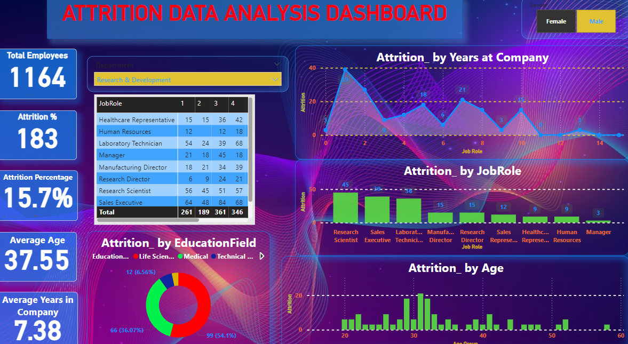
Mock-Up Dashboard

Slide 7
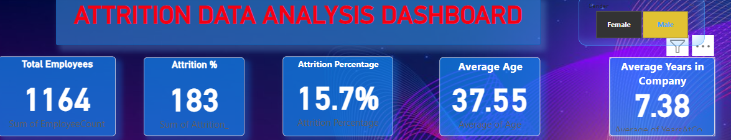
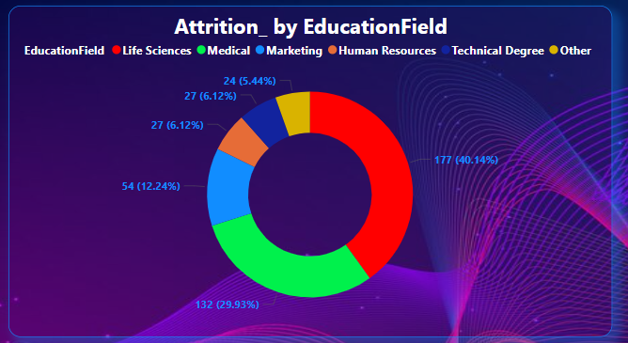
Data Analysis

Slide 8
Data Analysis

Slide 9
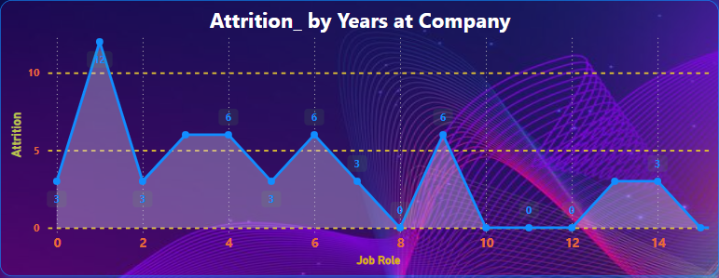
Data Analysis

Slide 10
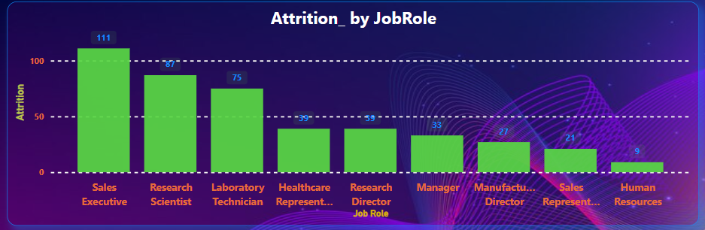
Data Analysis

Slide 11
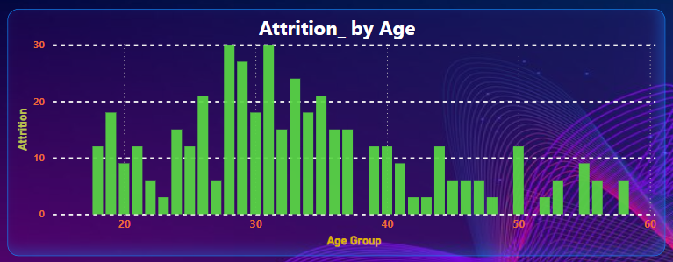
Data Analysis

Slide 12
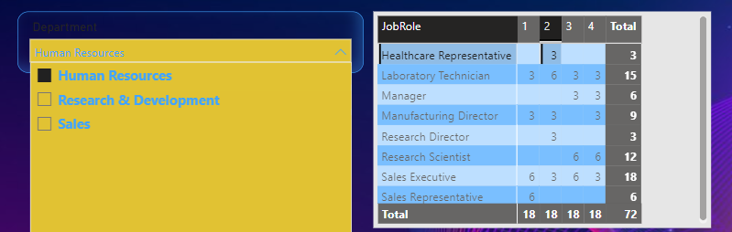
DATA ANALYSIS

Slide 13


THANK YOU

